Slide 1
Intro to Linux
Girl Develop It
9/17/2014
Yash Parghi

Slide 2
How does a computer work?

Slide 3
What is an operating system?

Slide 4
What is Linux?
An operating system
A kind of Unix

Slide 5
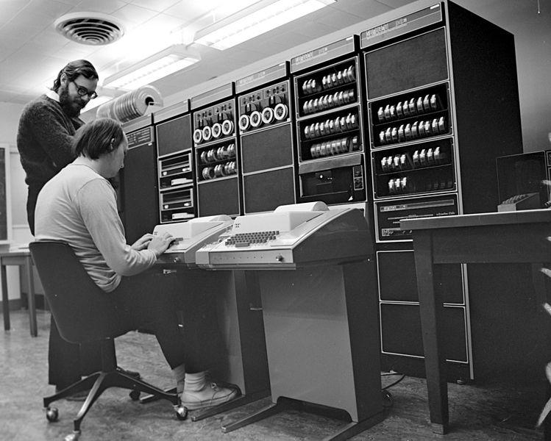
Unix history
Began in 1969
Thompson and Ritchie and team
Bell Labs (kinda)
Motivated by the idea of a shared system
Wikipedia, "History of Unix"
Creative Commons Attribution-ShareAlike 2.0 Generic
Notes:
Photo: Thompson and Ritchie working on a PDP-11, a computer that ran "The first officially named version of Unix" (wikipedia)

Slide 6
Linux history
Began in 1991
Personal project by Linus Torvalds
Expanded from a small educational Unix called Minix
comp.os.minix, 10/5/1991: "I'm doing a (free) operating system (just a hobby, won't be big and professional..."
A part of open source history

Slide 7
Open up Linux
Look at your neighbors' screens

Slide 8
Open up Linux (cont.)
Look at your hard disk and files
Look at your memory
Look at your CPU
Look at your processes

Slide 9
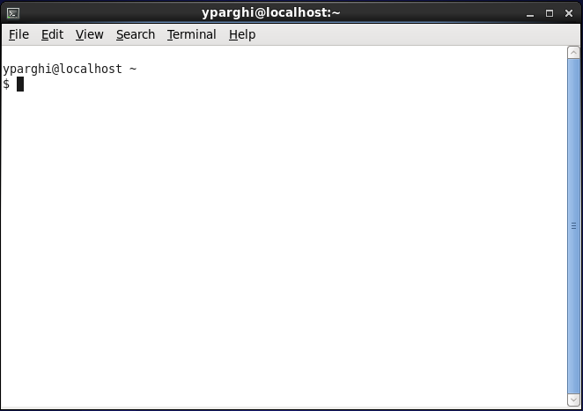
Open your Terminal

Slide 10
Use your Terminal
Type in some nonsense and hit enter
Do it again
Hit the up, down, left, and right arrows
Try backspace

Slide 11
Use your Terminal correctly
Look at your files: ls
Don't forget the ls command. Use it to get your bearings at any time.
Look at your memory: free
Look at your CPU: top
Look at your processes: ps

Slide 12
The Linux filesystem
Starts at /
Everything is subfolders under that: /home /home/myself /home/myself/Documents
pwd, ls, ls -l, cd, . and ..
What is /home? What is ~?

Slide 13
Exercises
Read up on the ls command and figure out how to show filesizes in a human readable format, e.g. 4096 (bytes) shows as "4K".
man ls
man (manual) pages explain commands. They are your friend.

Slide 14
Manipulating files (writing stuff)
Go to your home directory.
Make a few files:
touch
echo "hello" > hello.txt
What do you think this does?
cat
cp
mv
rm
man pages!
Notes:
Talk through the exercises, let them play with them, then regroup after to walk through them.

Slide 15
Manipulating directories
mkdir
rmdir
How do you write a file inside a directory?
Exercise: Write a file inside a directory and try to rmdir it. What happens? How do you overcome that?
man rmdir?

Slide 16
Pipes: combining commands
Using Linux (and building software) is about combining small parts, over and over, until you've built something.
Linux makes it easy to combine commands.
Pipes connect the output of one command to another:
ls | grep "m"

Slide 17
Exercise
Find the pipe on your keyboard.
Write a list of fruits to a file called fruits.txt.
echo "pear" >> fruits.txt
What does this do?
Print out your list of fruits.
Print out fruits containing the letter "a".
Print out fruits in sorted (alphabetical) order.
Print out fruits containing the letter "a" in sorted (alphabetical) order.
What if you have fruits.txt and vegetables.txt and you want to process them as one list?

Slide 18
Processes
Every command you run is given its own container by the operating system. The container is called a process.
In other words, a process is a unit of execution in an operating system. One command, one process.
Processes answer the question "What's going on?" on a computer.

Slide 19
Processes (cont.)
ps
ps aux
top
What properties does a process have?

Slide 20
Exercises
sleep 5
sleep 5 &
sleep 30 & then ps
sleep 30 then Ctrl-C
sleep 30 then Ctrl-Z then fg
sleep 30 then Ctrl-Z then bg then ps
Start a long sleep, send it into the background, find its PID, and kill it.
man kill

Slide 21
Processes (Conclusion)
Small, self-contained parts working together to comprise a whole system
Thought exercise: how would you use separate processes to download health data every 30 minutes from some website, process it looking for patterns, and send an email out whenever a flu epidemic is detected?

Slide 22
Linux and making software
A software system is a collection of processes.
Exercise:
Start a web server:
python -m SimpleHTTPServer 9090
Send it to the background and keep it running
Visit it in your web browser: "http://localhost:9090"
Visit it in your terminal: curl localhost:9090
Kill the server
Try visiting it again

Slide 23
Shell scripting
Every mature software system is horrifically cobbled together.
Shell scripts are how we cobble.
Write a sequence of commands in a text file, save the file, and run the file ("script") all in one go.

Slide 24
Exercise
Open a text file demo.sh in a text editor.
gedit, or nano if you have it, or vi if you know it.
Follow along with the demo.
Make your own show_processes.sh that takes one argument and displays all processes containing that word.
Notes:
Demo: echo "Hello"; echo "You typed in" $1; ls -l; echo "Those are your files"

Slide 25
What now?
Pick something you want to make and pursue it single-mindedly.
Examples:
Set up a website on your laptop using Apache and a programming language you're interested in, e.g. Ruby on Rails or PHP.
Set up a MySQL or Postgres database, fill it with data, and learn how to query it.
Download an open-source project using git/Github and learn how to compile and run it on your laptop.

Slide 26
Resources
http://wiki.ubuntu-women.org/
http://anitaborg.org/get-involved/systers/
http://www.devchix.com/
EdX Intro to Linux

